Slide 1
Measuring Malaria in Complex Transmission Systems
A Time-at-Risk Based Approach
Alec Georgoff
MMC Meeting, Bangkok, Thailand
November 30, 2018

Slide 2
Introduction

Slide 3
Objectives

Slide 4
Objectives
Mathematical
Underpinnings
The basics of mosquito math
Vector-Based
Approach
Multiple locations in one equation
Simple
Example
One village, one forest
Expanded
Example
More villages, more forests!!
R
Implementation
Making computers do the hard math

Slide 5
Mathematical Underpinnings

Slide 6
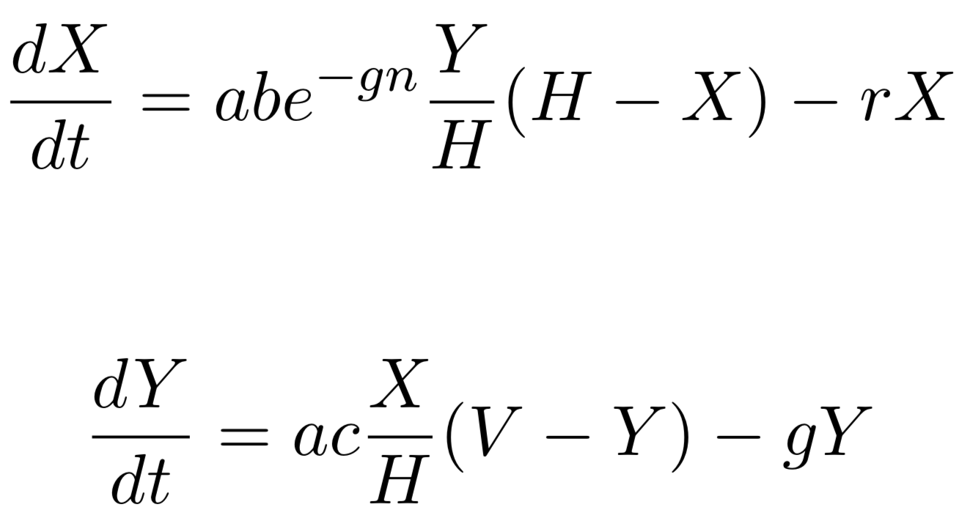
Ross-Macdonald Equations
Infected Humans
Infected Mosquitoes

Slide 7
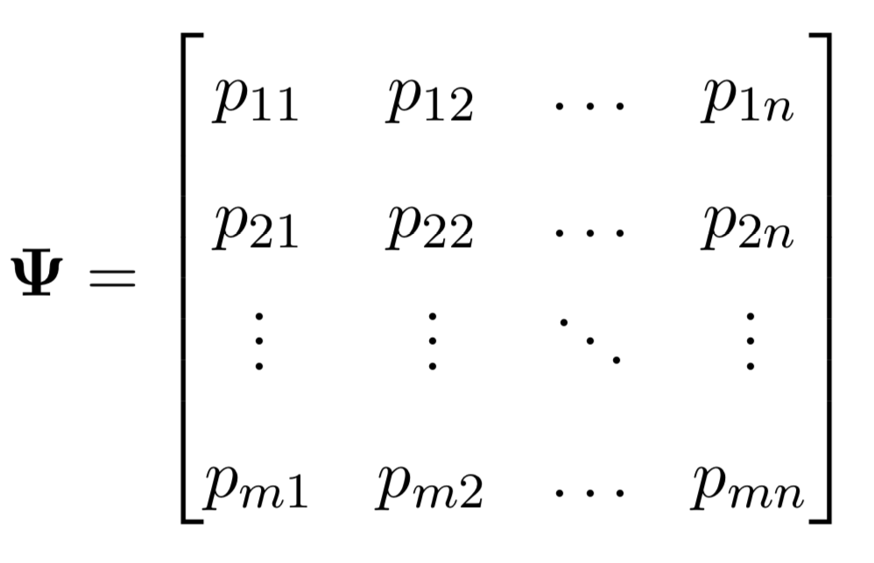
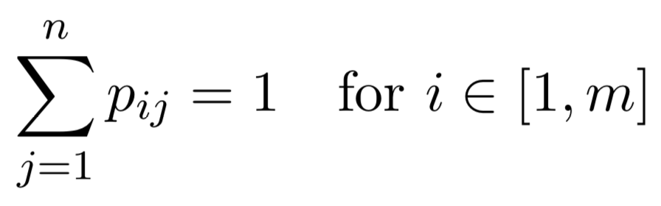
Time-at-Risk (TaR)

Slide 8
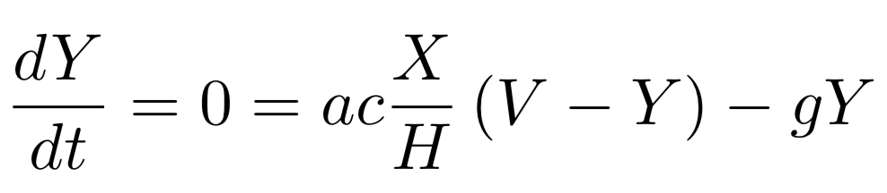
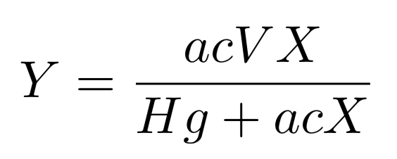
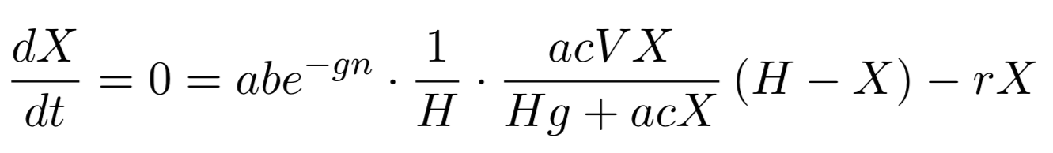
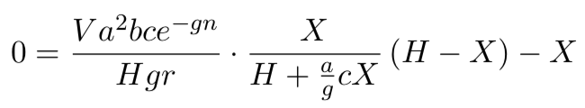
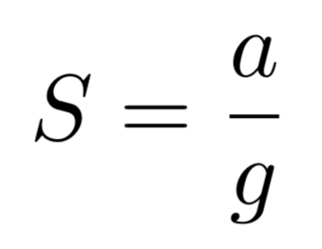
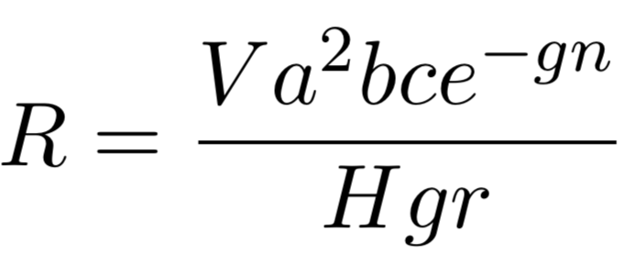
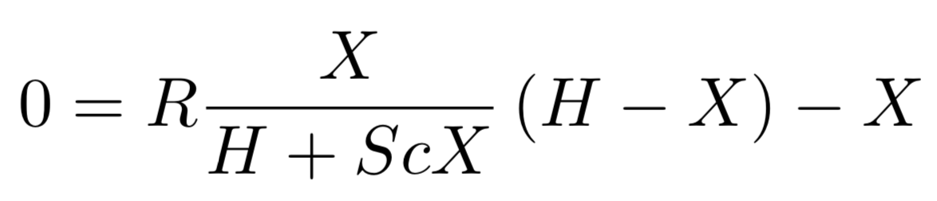
Equilibrium Assumptions

Slide 9
Equilibrium Assumptions

Slide 10
Equilibrium Assumptions

Slide 11
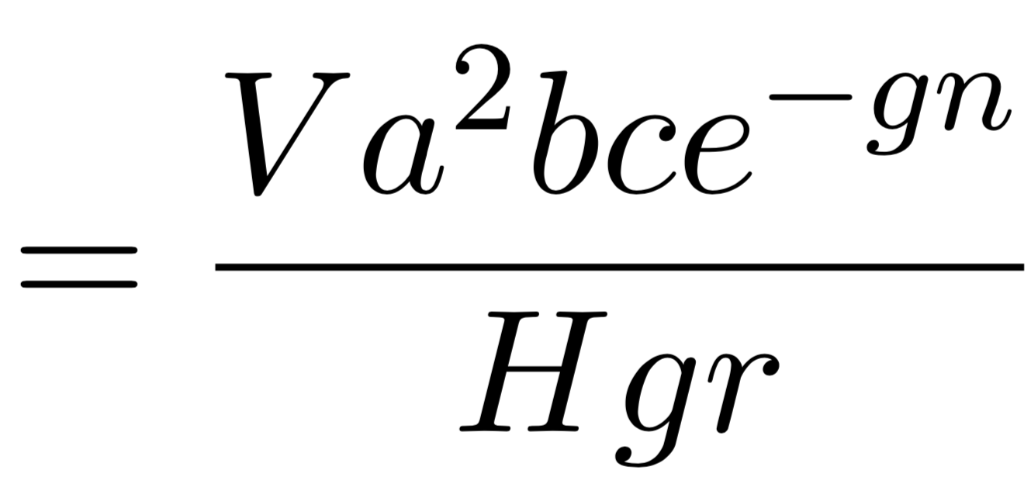
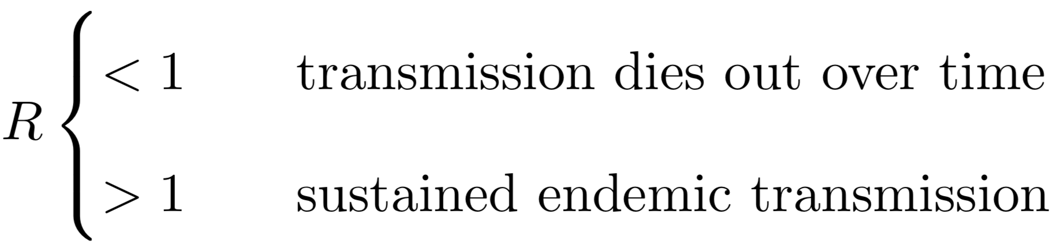
Reproductive Rate

Slide 12
Vector-Based Approach

Slide 13

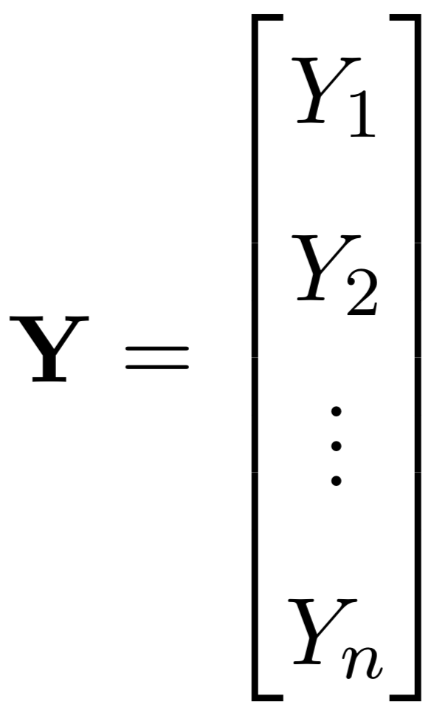
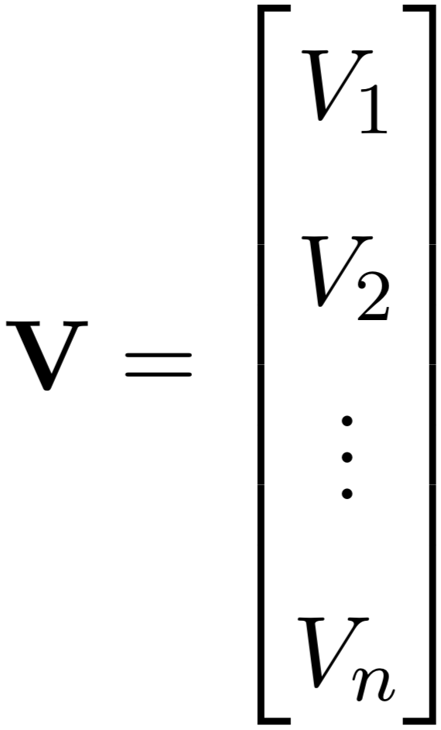
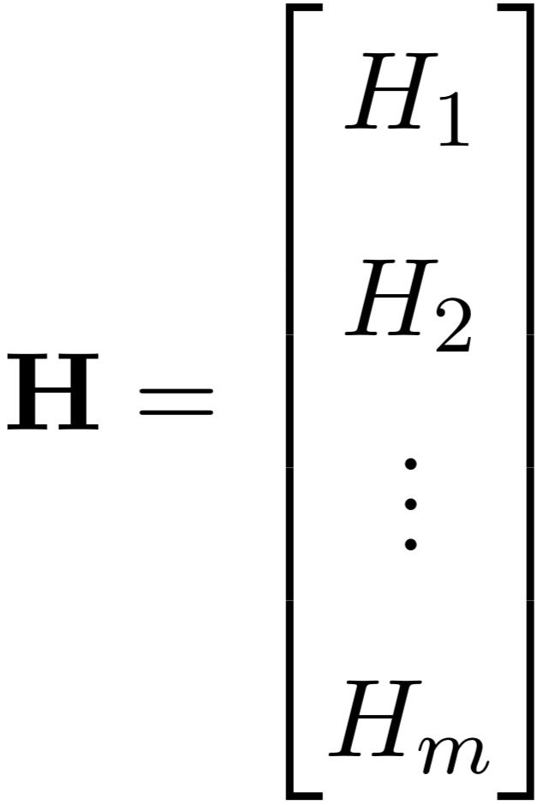
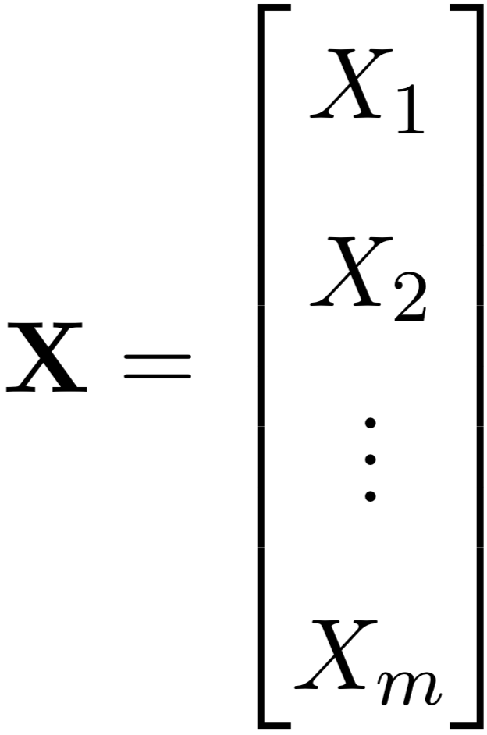
Vectors of Variables

Slide 14


Scaling by Time-at-Risk

Slide 15
Ross-Macdonald Equations

Slide 16
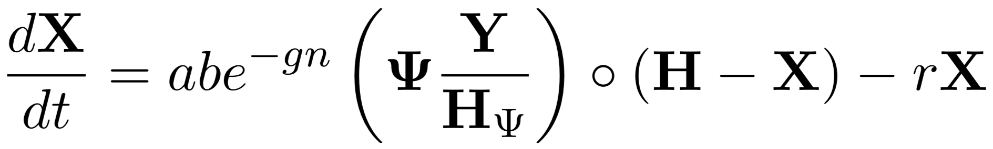
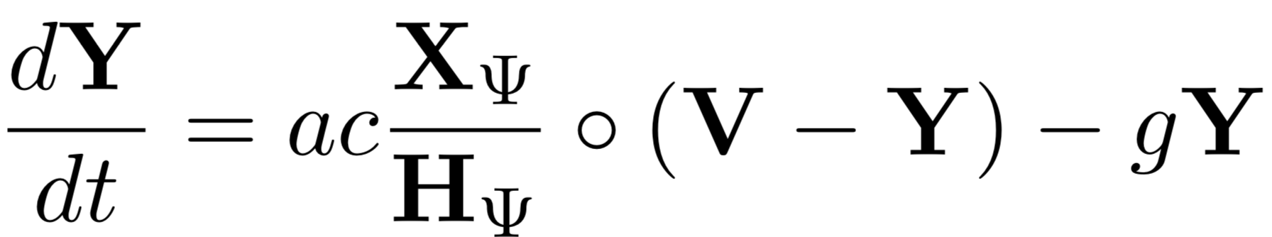
Ross-Macdonald Equations

Slide 17
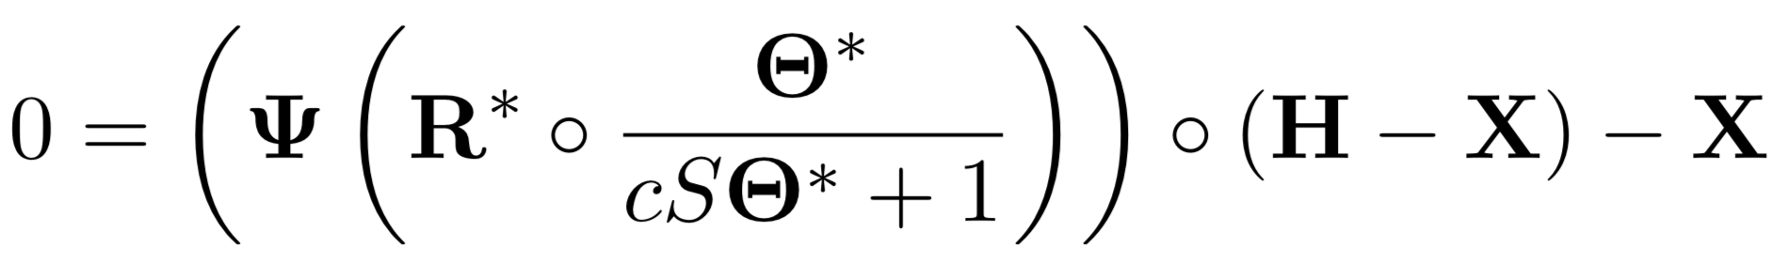
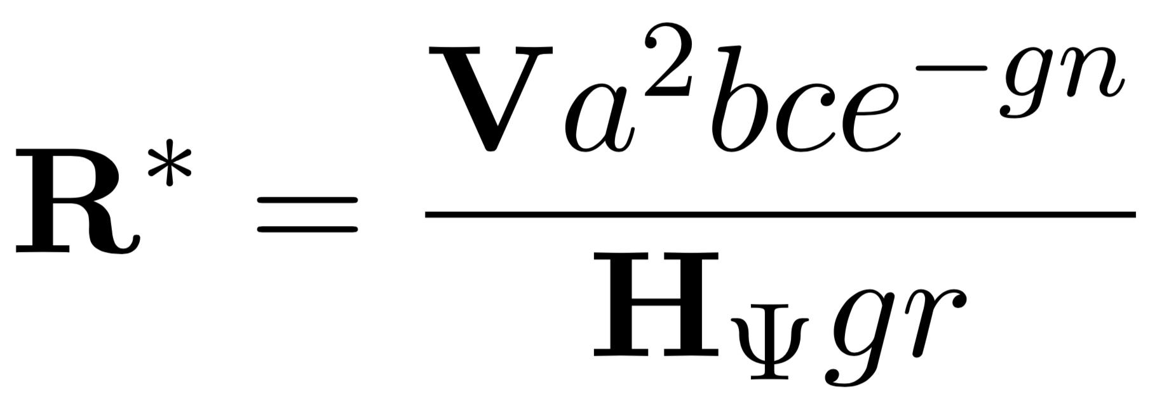
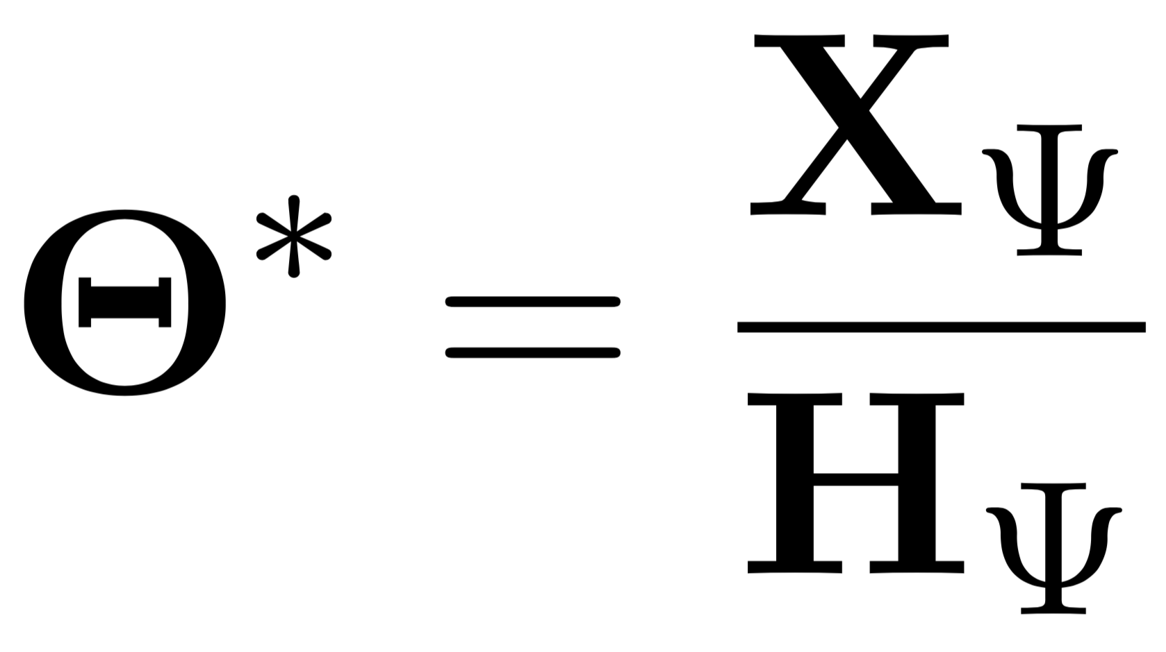
Equilibrium Assumptions

Slide 18
Simple Example

Slide 19
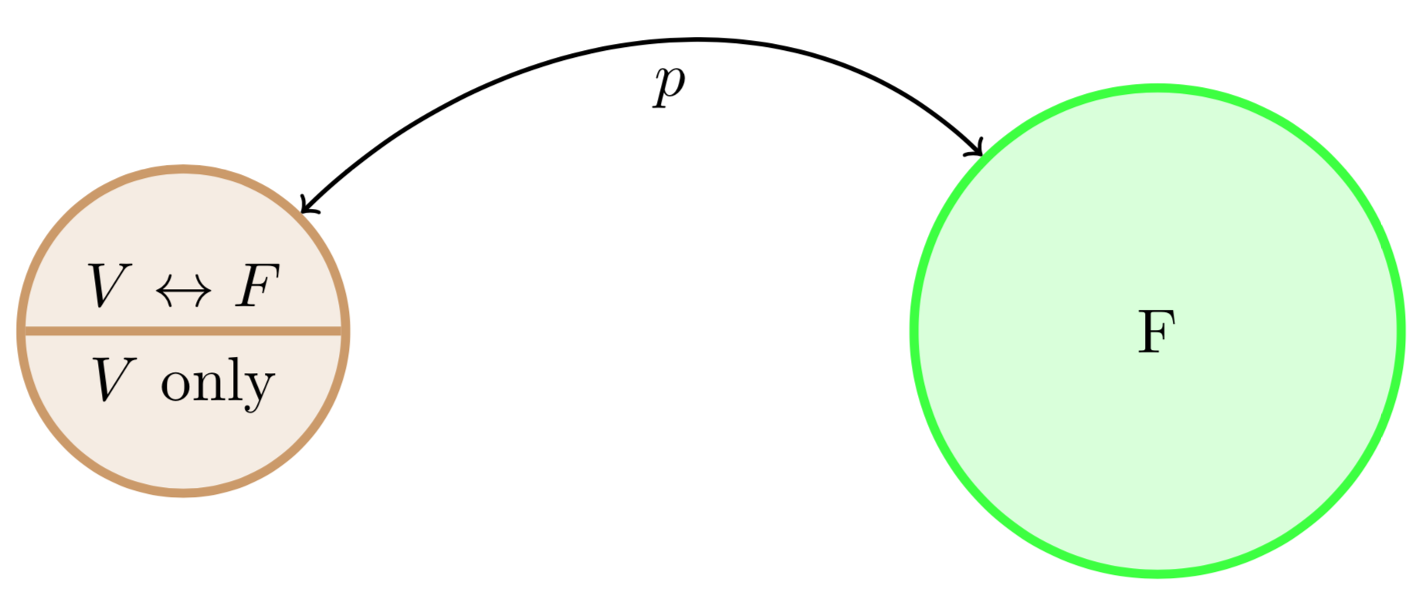
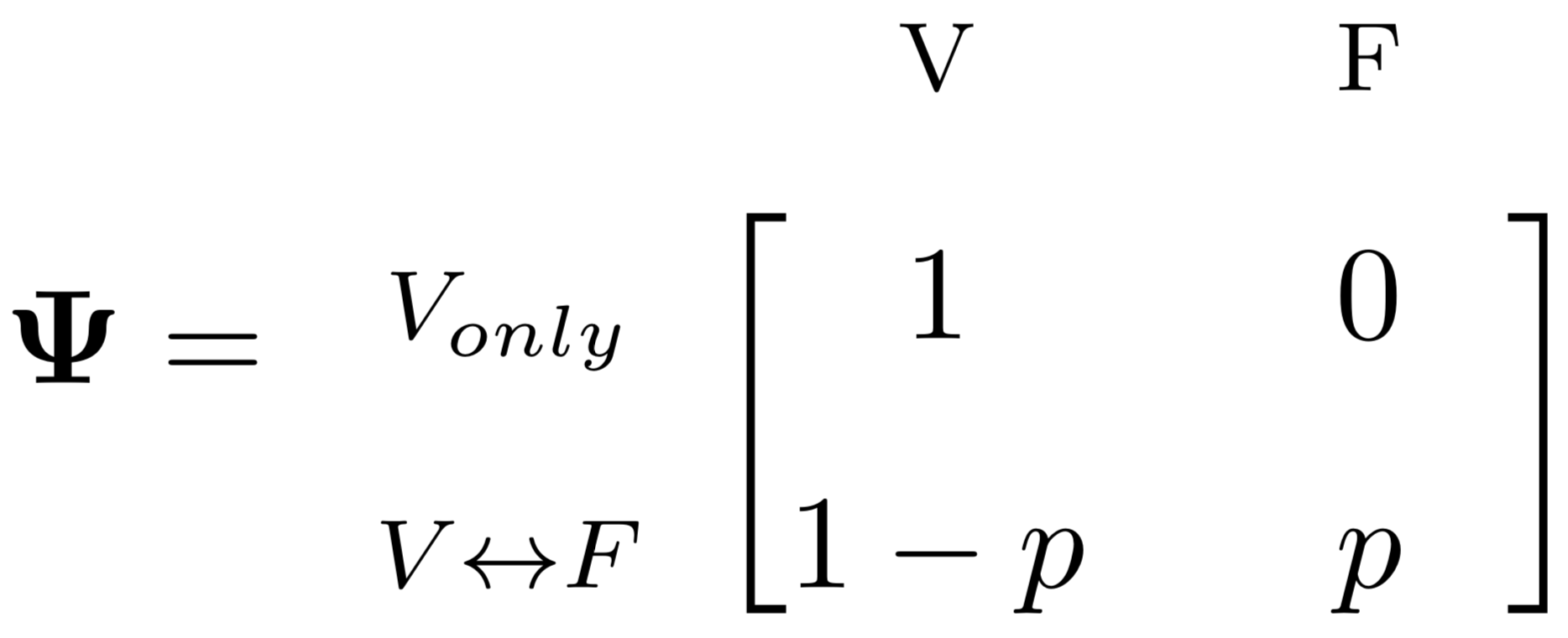
Simple Example: One Village, One Forest

Slide 20
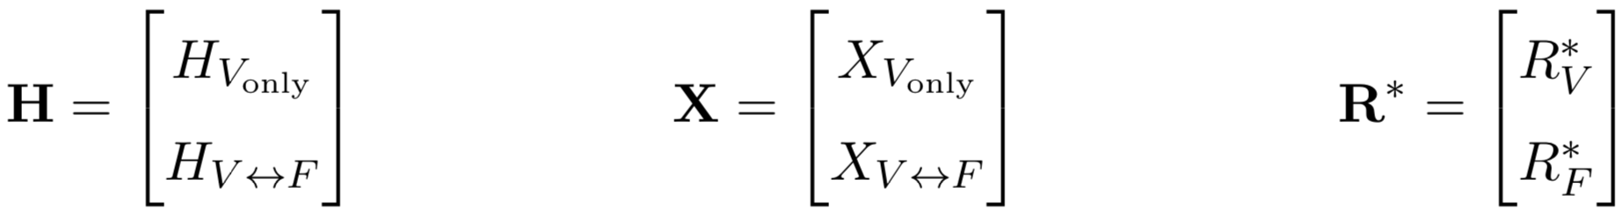
Simple Example: One Village, One Forest

Slide 21
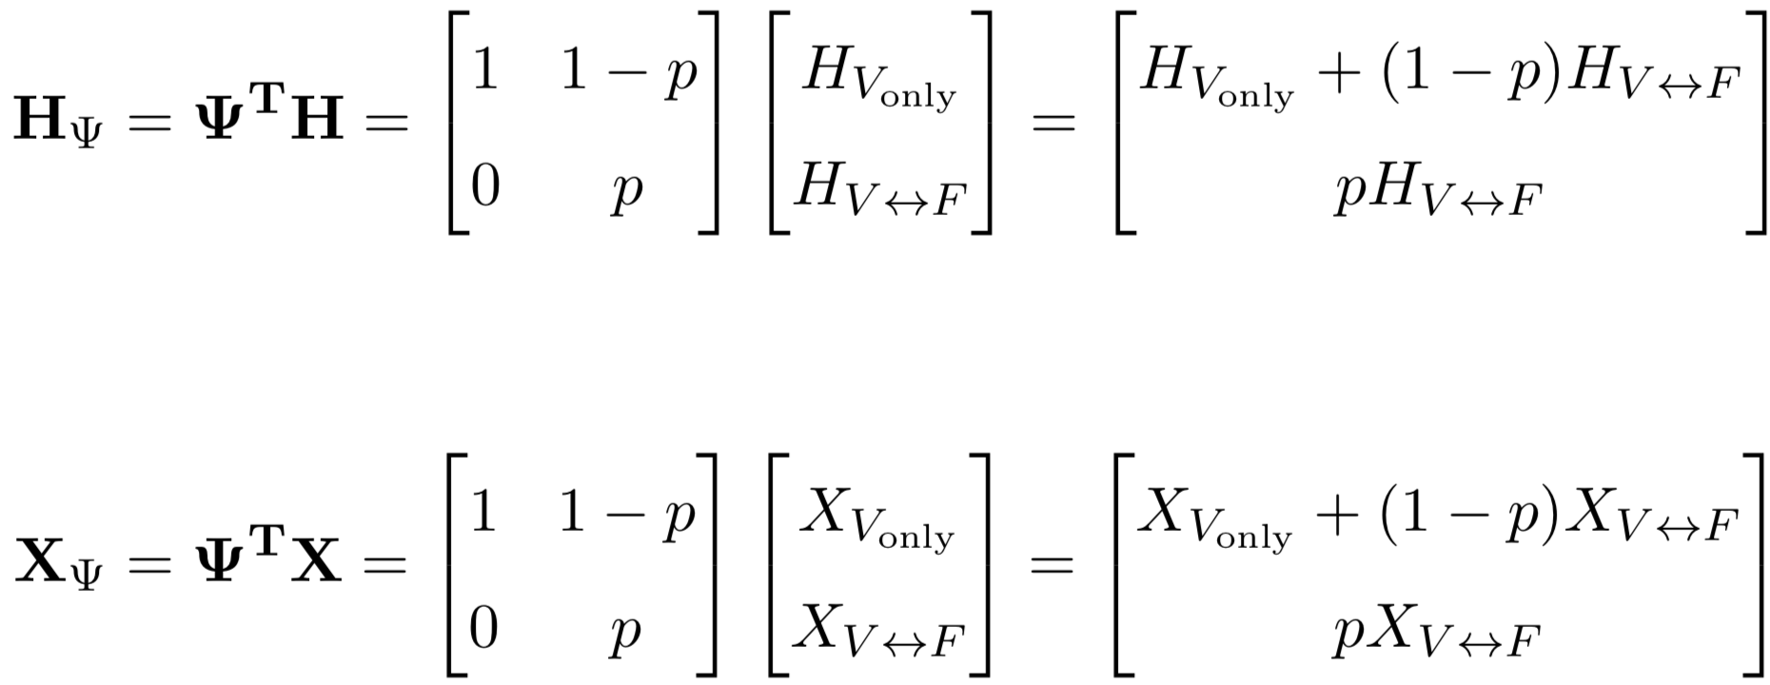
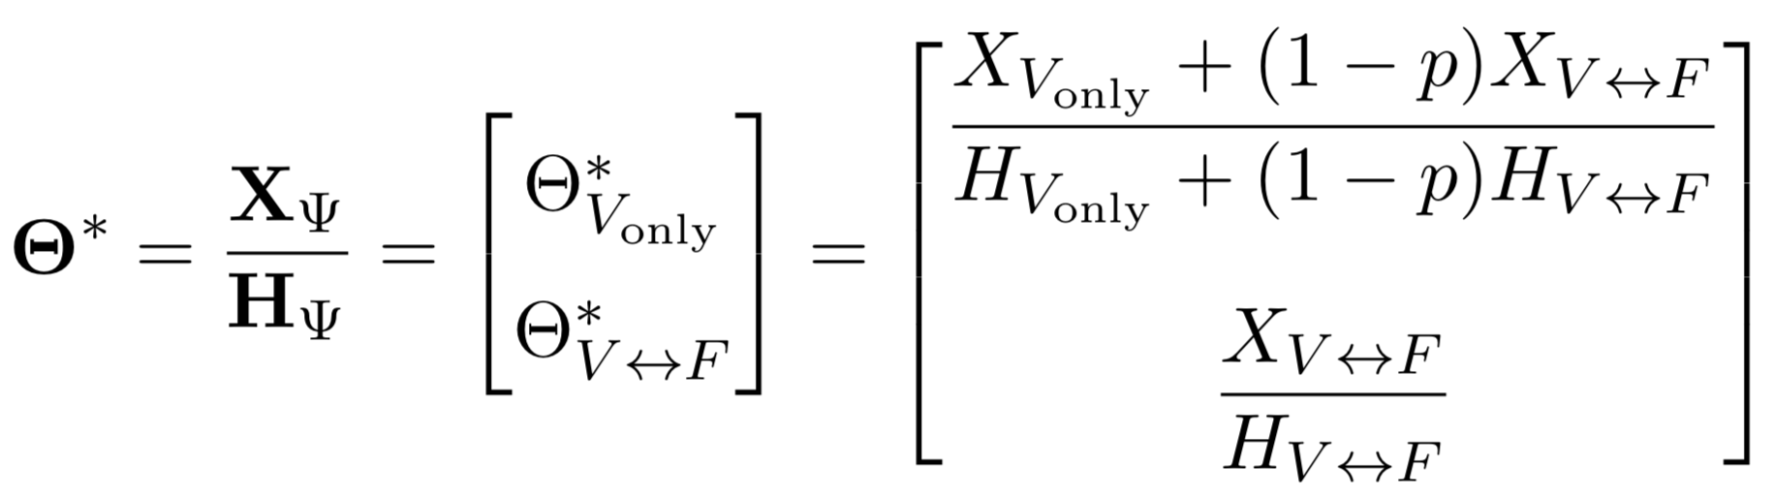
Simple Example: One Village, One Forest

Slide 22
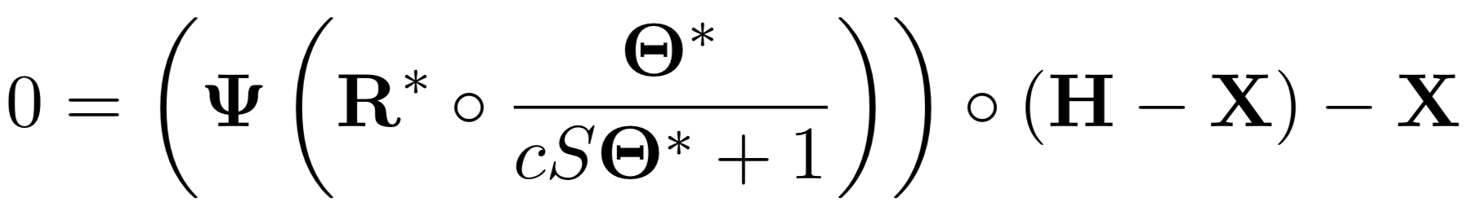
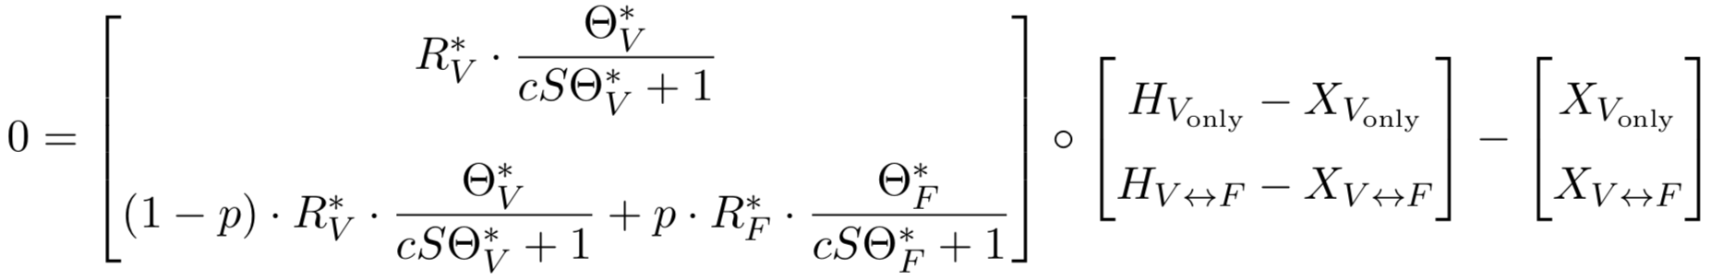
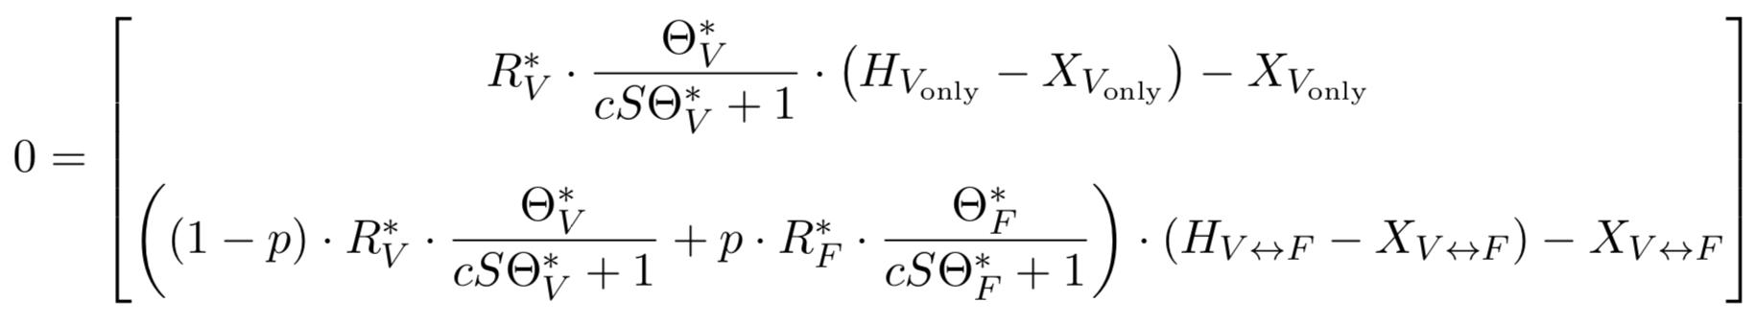
Simple Example: One Village, One Forest

Slide 23
Expanded Example

Slide 24
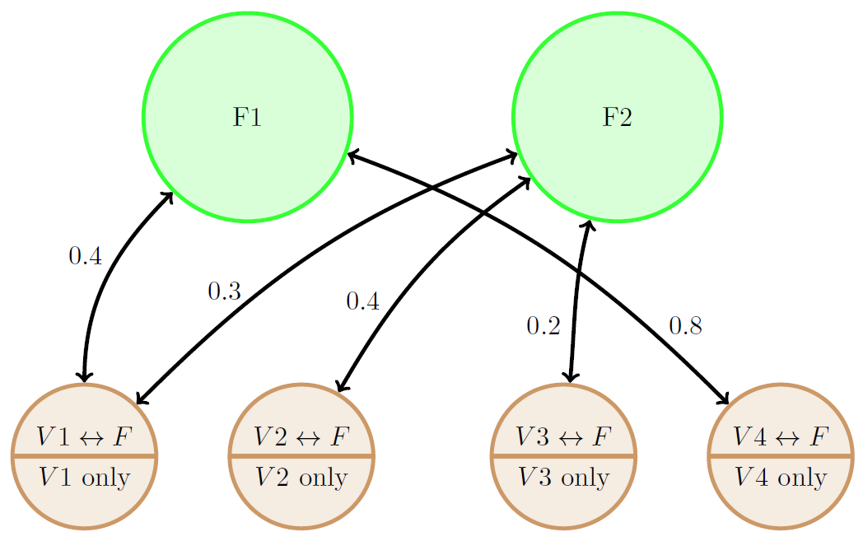
Expand to More Villages and Forests

Slide 25
Expand to More Villages and Forests

Slide 26
Expand to More Villages and Forests

Slide 27
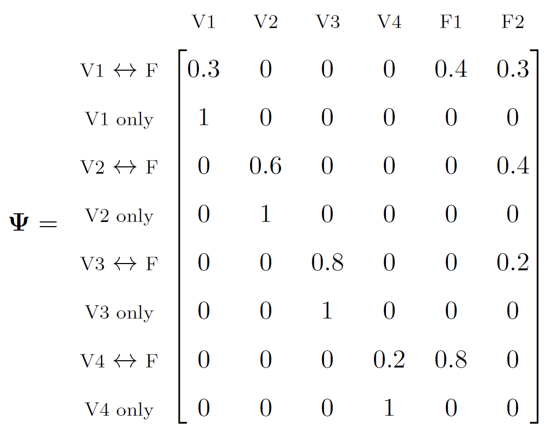
Expand to More Villages and Forests

Slide 28
Implementation In R

Slide 29
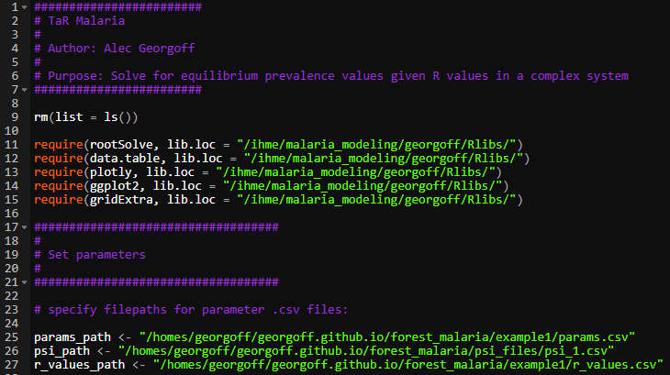
R Code

Slide 30
R Code

Slide 31
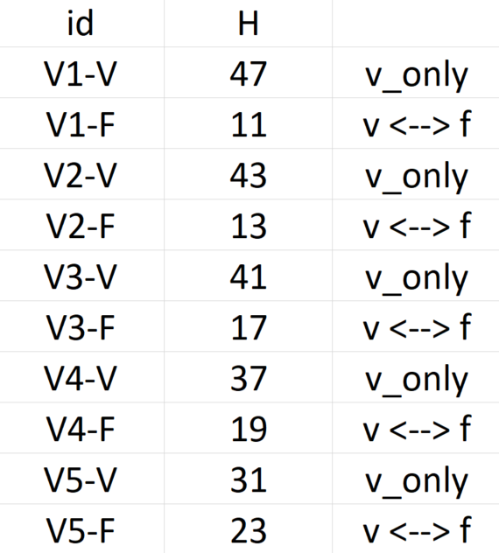
R Code – Parameters

Slide 32
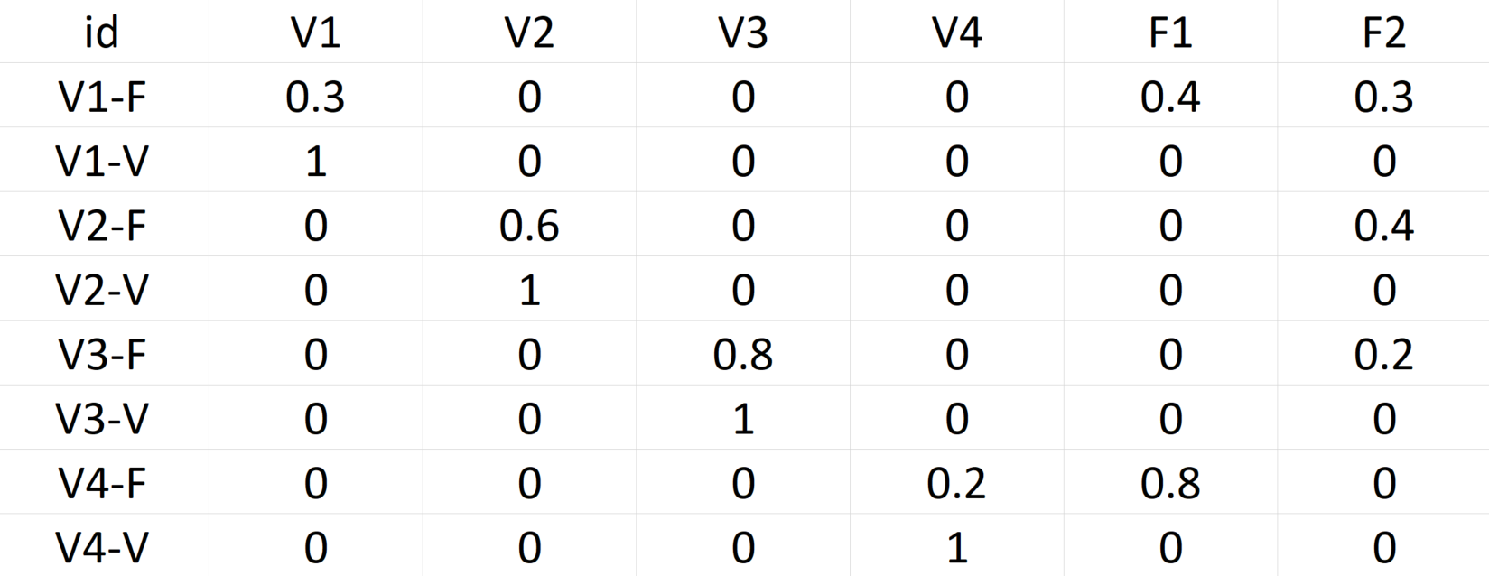
R Code – TaR Matrix

Slide 33
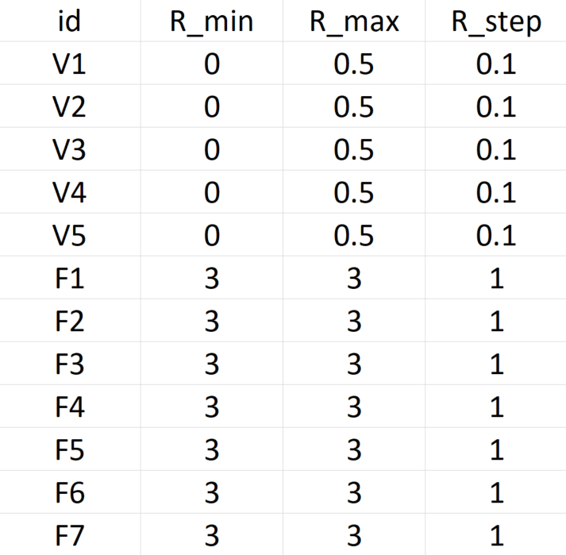
R Code – R Values

Slide 34
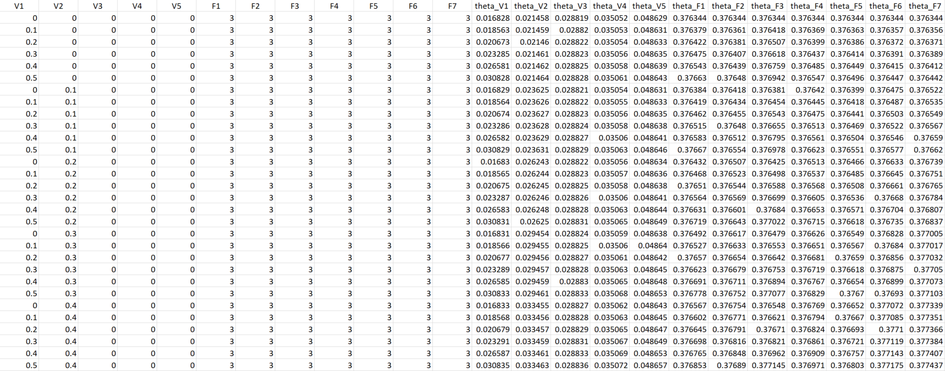
R Code – Results
7776 Rows

Slide 35
Visualizations

Slide 36
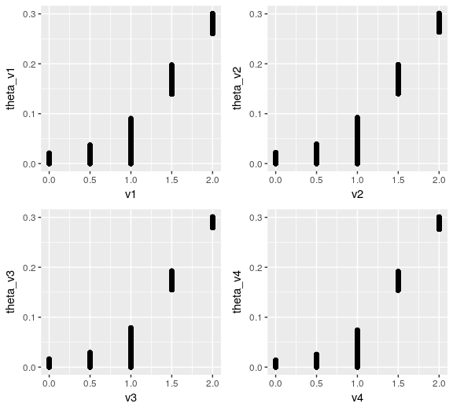
Visualizations

Slide 37

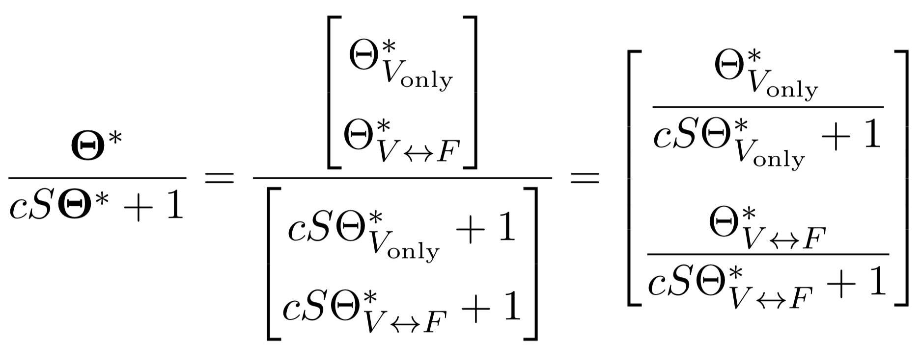
Simple Example: One Village, One Forest
Notes:
delete

Slide 38
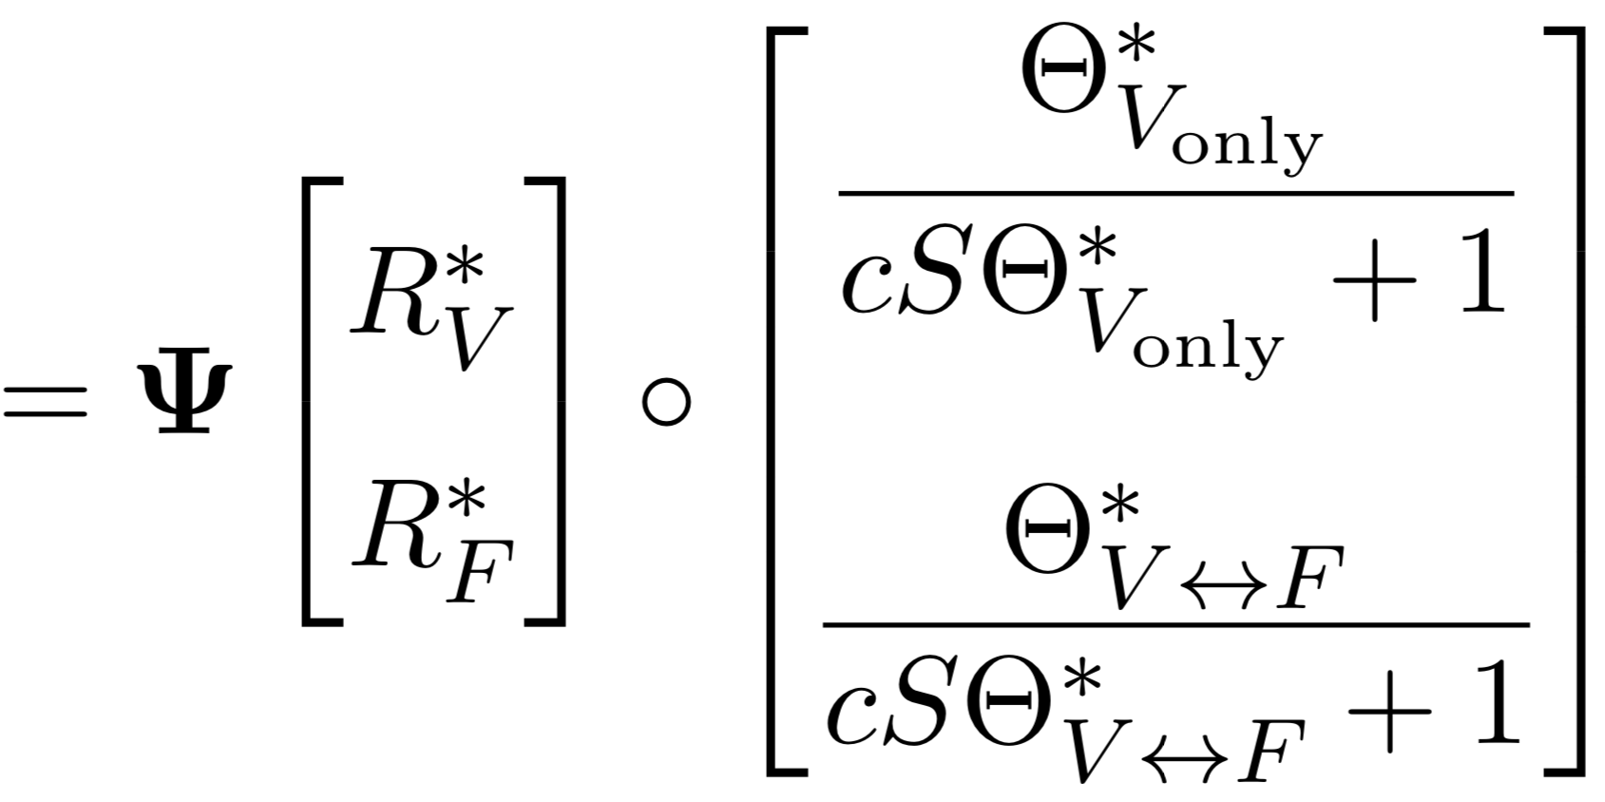
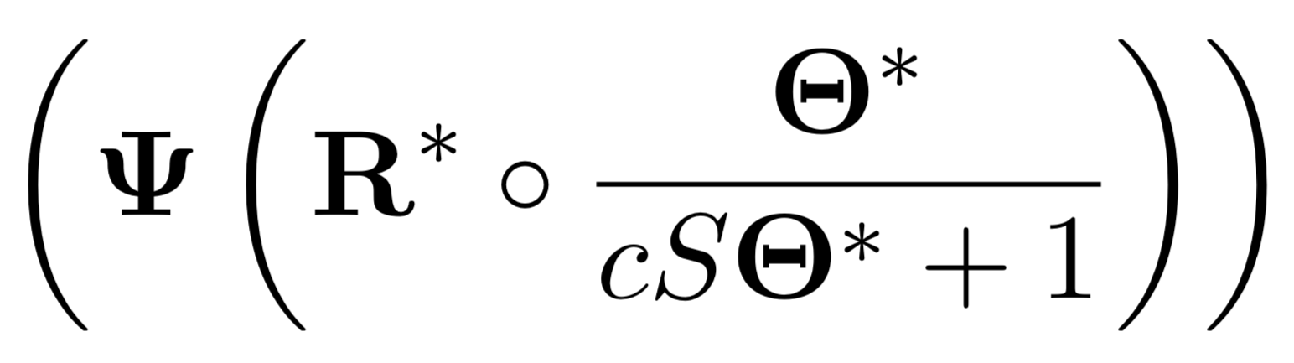
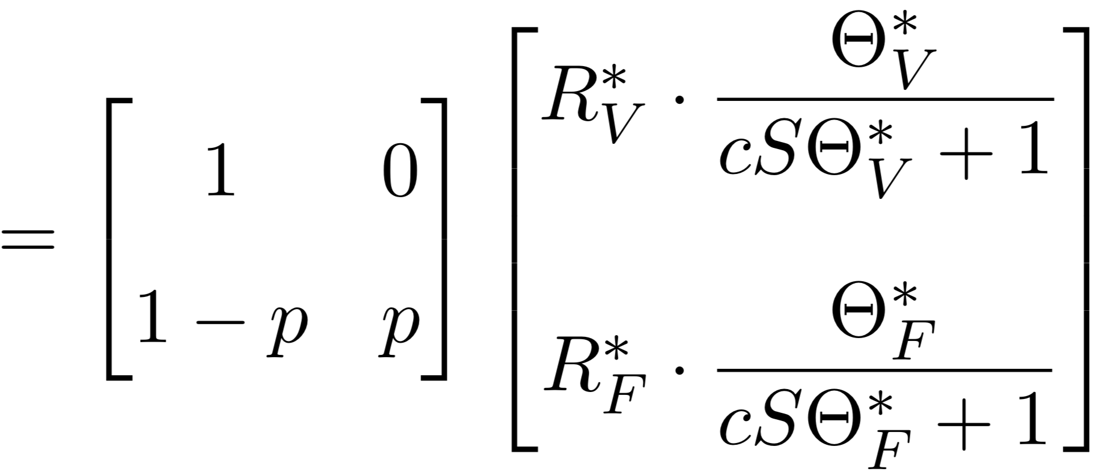
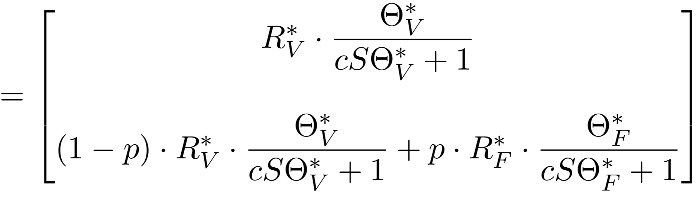
Simple Example: One Village, One Forest
Notes:
delete

